Slide 1
Agile Change Management

Slide 2
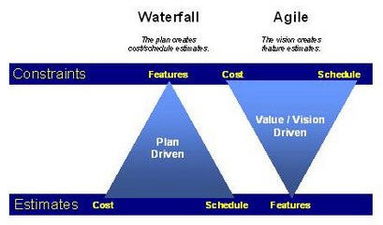
Iron Triangle

Slide 3
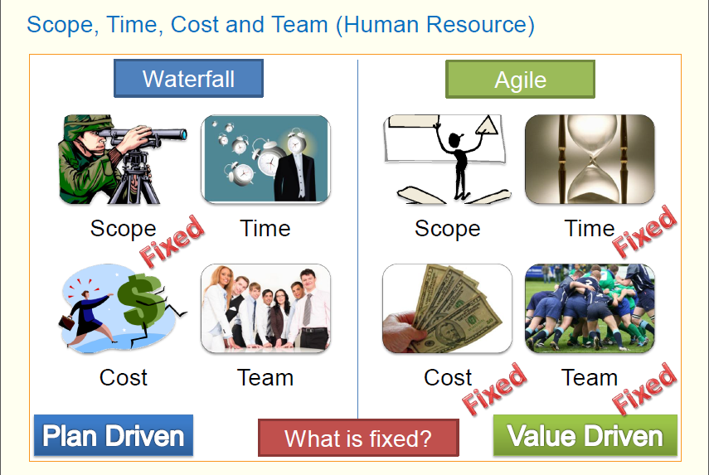

Slide 4
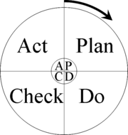
Change Management Process

Slide 5
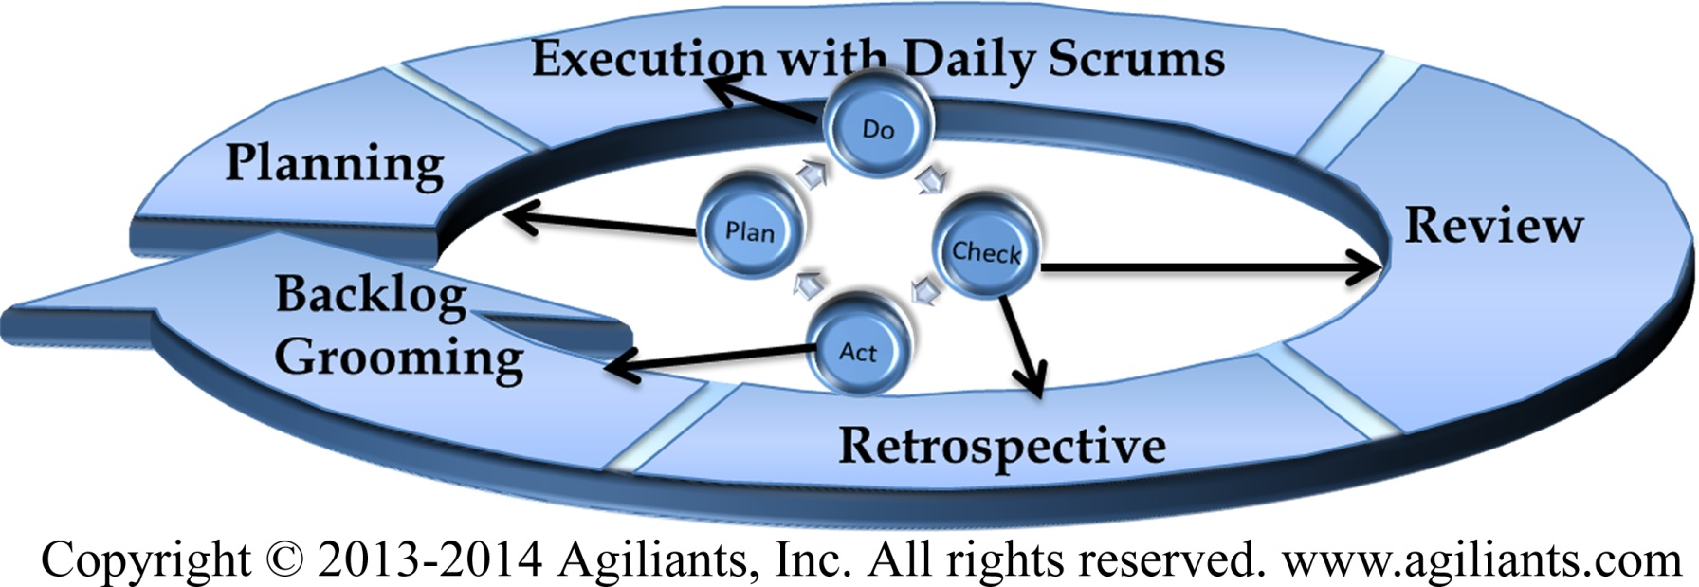
Change Management Process = Scrum Life Cycle

Slide 6
Holistic View of Agile Change Management
planning
Controlling
Adapting

Slide 7
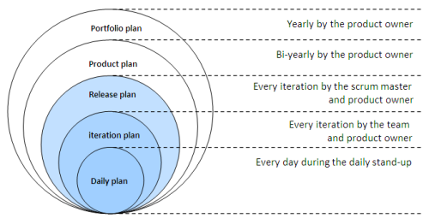
Planning For Change
Planning vs plan

Slide 8
Control The Change
User Stories that INVEST 3 Cs Sprint planning ( Commitment /Velocity based) Sprint Goal & Definition of Done | Small Customer Centric Features Acceptance Criteria Fixed Scope, Fixed Time , Fixed Cost
Test Driven Development/Pair Programming /Refactoring Daily Automated Builds | Quality Right First Time
Reduce WIP limit | Reduce Waste and Rework
Backlog grooming Sprint Readiness | Planning / Dependency Management
Testing (functional /integration/Regression/Performance Sprint Review and Feature Validation | Inspect and Adapt.
Sprint Contract

Slide 9
Adopt the change
Exchange Requests – not Change Requests
Re-estimate
Re-plan
Update Release Plan

Slide 10
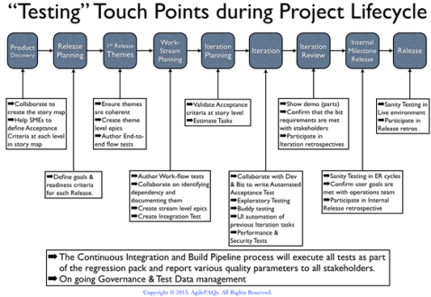
Quality in Built

Slide 11
Exercise
Waterfall vs Agile Scope Management

